Slide 1
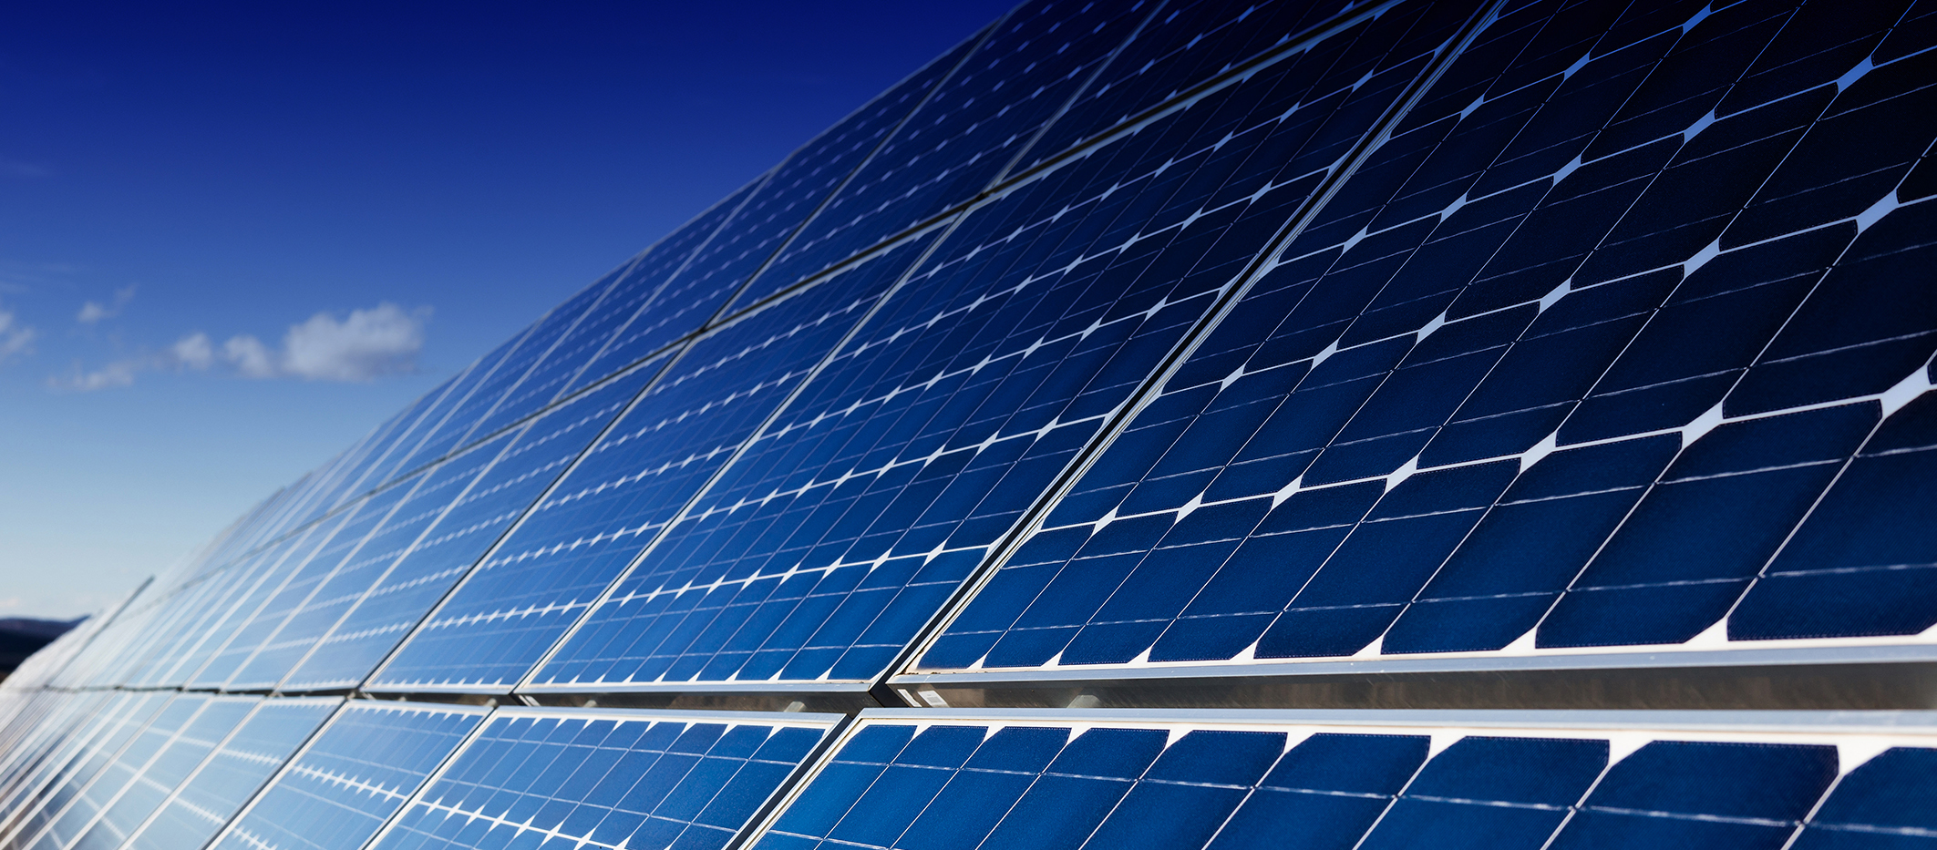
Threats Introduction
Power Sector Resilience Planning Guidebook
The following slides are intended to provide additional background information and examples of power system threats. They can serve simply as a reference or can be used in local power sector resilience assessment workshops. For questions or more information on the slides, use the “Ask An Expert” feature on the Resilient Energy Platform website.

Slide 2
Outline
Power Sector Threats:
Natural Threats
Technological Threats
Human-Caused Threats

Slide 3
Definitions
Threat*: Anything that can damage, destroy or disrupt the power sector. Threats can be natural, technological, or human-caused. Threats are typically not within the control of power system planners and operators and can include wildfires, hurricanes, storm surges, system malfunctions, and cyber attacks. This term is often used interchangeably with hazard.
Hazard: Often used interchangeably with threat.
*Many different definitions exist for the terms threats, hazards, impacts, vulnerabilities, and resilience that encompass different factors. We propose these “working definitions” for the purposes of this guidebook. We invite readers to explore other definitions in the future.

Slide 4
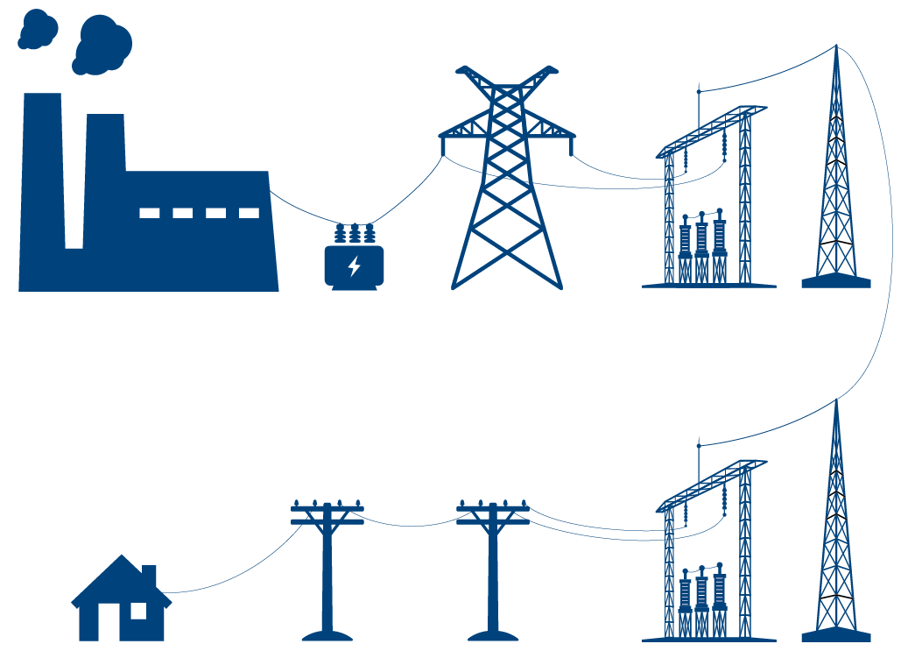
Overview of Power Sector Threats
Natural
Technological
Human Caused
Operations
Power Plant
Step-up transformer
Transmission
Transmission Substation
Workforce
Load
Distribution
Distribution Substation
Finance

Slide 5
Natural Threats

Slide 6
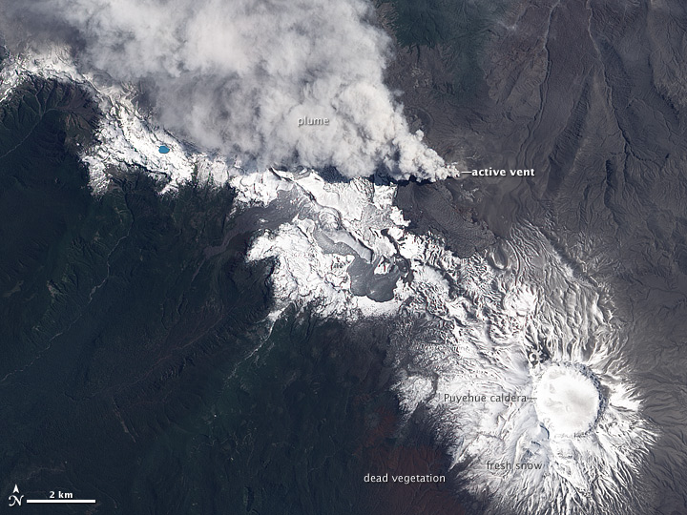
Natural Threats May Include:
Cyclones (typhoons and hurricanes)
Extreme precipitation
Extreme heat and cold
High Winds
Drought
Landslides
Earthquakes
Volcanic Eruptions
Sinkholes
Space Weather Events (such as solar flares)
Wildlife Interactions
Lightning
Flooding
Others
Figure. Nasa. Satellite: Aqua. Eruption of Puyehue-Cordón Caulle Volcano from June 2011, Chile from:https://eoimages.gsfc.nasa.gov/images/imagerecords/76000/76810/puyehue_ali_2011357.jpg

Slide 7
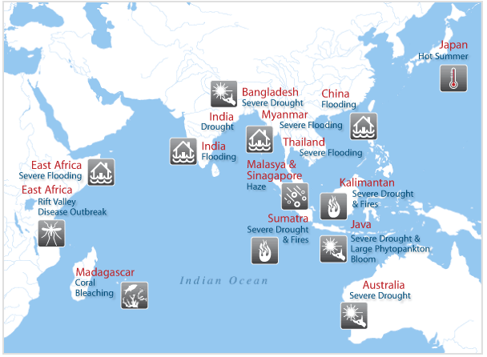
Natural Threats Vary Widely and are Location Specific
Example: In one given year, climate shifts can have vastly different effects—from flooding in East Africa to drought in Indonesia.
Source: Tan, Chun Knee, 2010, https://ourworld.unu.edu/en/indonesia-drought-kenya-flooding
Notes:
These are the specific climate threats identified by 17 US utilities that took part in a DOE climate vulnerability working group. As you can see, the climate threats to the electric utilities varied based on location and assets

Slide 8
Natural Threats Vary Widely and are Location Specific
Example: projected increases (green) and decreases (red) in hydropower generation. Due to climate impacts on river flows, South Africa, Brazil, Afghanistan, Tajikistan, and Venezuela are forecast to have large reductions in hydropower potential.
Notes:
These are the specific climate threats identified by 17 US utilities that took part in a DOE climate vulnerability working group. As you can see, the climate threats to the electric utilities varied based on location and assets

Slide 9
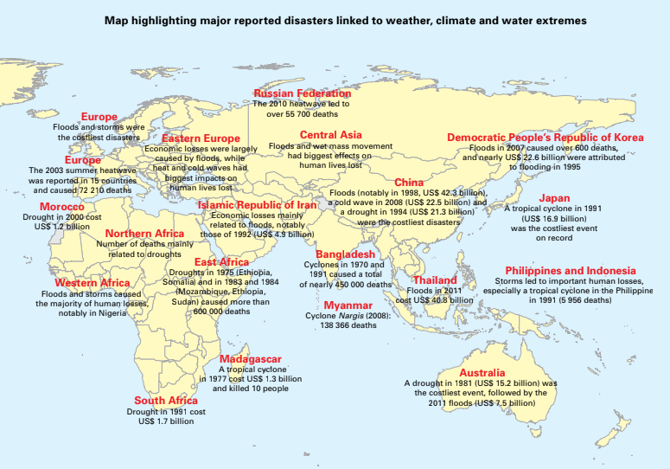
Economic Impacts of Natural Threats
Source: World Meteorological Organization, 2015 ATLAS OF MORTALITY AND ECONOMIC LOSSES FROM WEATHER, CLIMATE AND WATER EXTREMES (1970–2012)

Slide 10
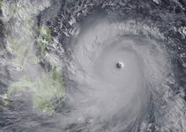
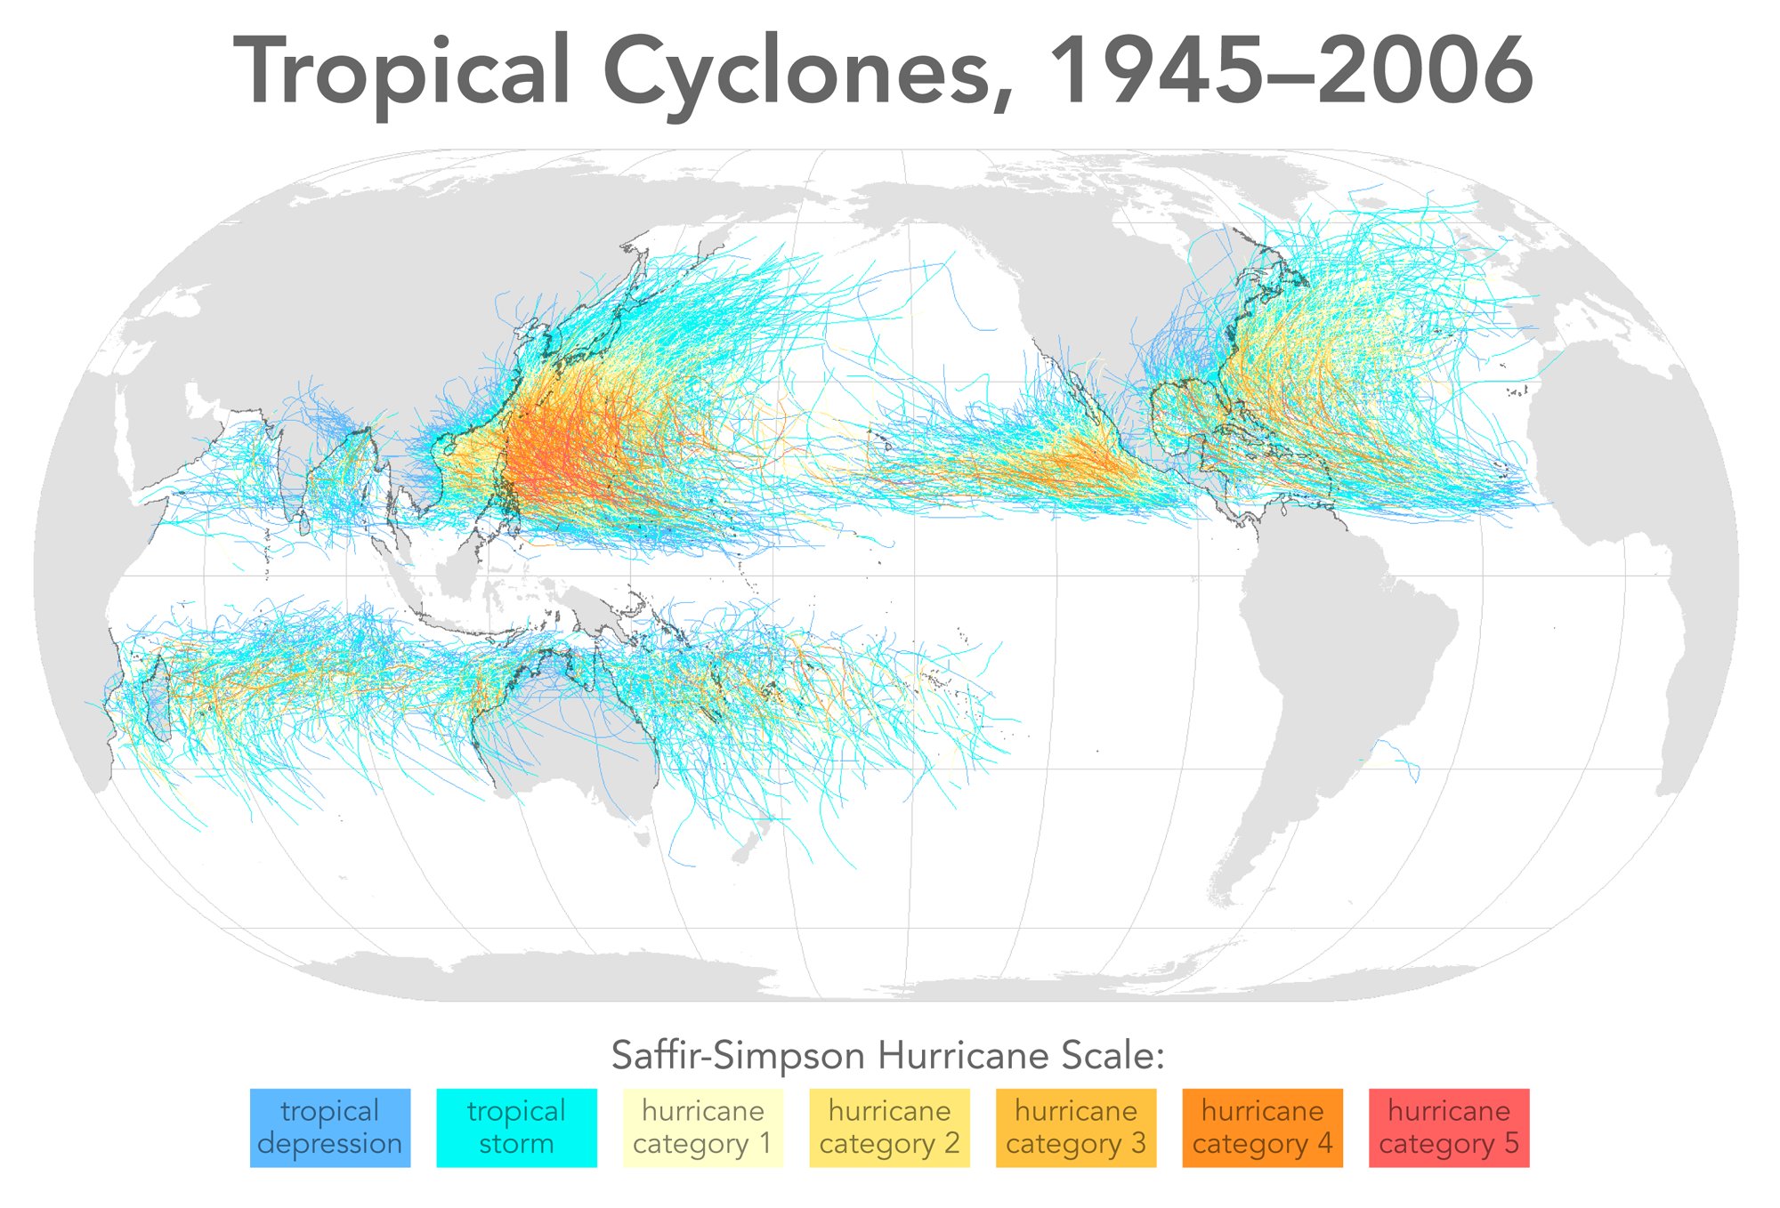
Natural Threats: Hurricanes/Typhoons/Cyclones
Climate Forecasts Vary:
Hurricane/typhoon/cyclone intensity increases of 2–11% by 2100.
Hurricane/typhoon/cyclone frequency decreases of 6–34% by 2100.
Substantial increases in the frequency of the most intense cyclones
Increases of the order of 20% in the precipitation rate within 100 km of the storm center.
Large variation by basin
Detection and attribution difficult
Figure. NASA https://earthobservatory.nasa.gov/images/82372/typhoon-haiyan-approaches-vietnam
Source: Kuntson, et. al., 2010, Tropical Cyclones and Climate Change, Nature Geoscience
Source. Citynoise at English Wikipedia, CC BY-SA 3.0, https://commons.wikimedia.org/w/index.php?curid=18049077
Notes:
Example: September 2004: Hurricane Jeanne shut down several power plants and damaged power lines, resulting in nearly 2.6 million customers losing electrical service in northeast, central, and southwest Florida. Accompanying hot and humid weather forced voluntary, pre-arranged load control programs for customers to reduce power consumption during peak usage (NEI 2012, DOE 2004)
Example: October 2012: Ports and power plants in the Northeast, as well as oil refineries, fuel pipelines, and petroleum terminals, were either damaged or experienced shutdowns as a result of Hurricane Sandy. More than 8 million customers lost power in 21 affected states (DOE 2012a).

Slide 11
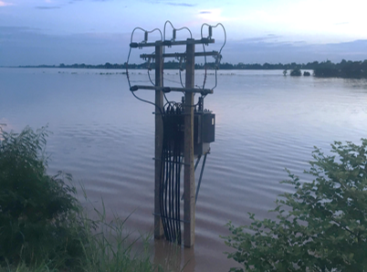
Natural Threats: Extreme Precipitation
Climate Forecasts:
Atmospheric water-holding increases roughly exponentially with temperature.
Observations confirm theory.
Mekong River flooding threat to distribution infrastructure in Vientiane, Lao PDR
Photo: Sherry Stout, NREL
Greenhouse gas increases have contributed to observed heavy precipitation event intensification
Source: Seung-Ki Min, et. al., 2011, Human contribution to more-intense precipitation extremes, Nature
Source: Vergara, Walter; Scholz, Sebastian M.. 2011. Assessment of the Risk of Amazon Dieback. A World Bank study. World Bank. © World Bank. https://openknowledge.worldbank.org/handle/10986/2531 License: CC BY 3.0 IGO.
Notes:
Example: May 2011: Nearly 20% of barge terminals along the Ohio River were closed due to flooding, impacting coal and petroleum transport. Flooding along the Ohio and Mississippi rivers also threatened oil refineries and infrastructure from Tennessee to Louisiana (Reuters 2011, EIA 2011c).
Example: June 2011: Missouri River floodwaters surrounded Fort Calhoun Nuclear Power plant in Nebraska. The nuclear reactor had been shut down in April 2011 for scheduled refueling, but the plant remained closed during the summer due to persistent flood waters (USNRC 2011).

Slide 12
Natural Threats: Extreme Heat
Observed and Projected Global Average Temperature Change
Source: IPCC AR5 WG2 Technical Summary
Notes:
Example: Summer 2011: Consecutive days of triple-digit heat and record drought in Texas resulted in the Electric Reliability Council of Texas declaring power emergencies due to a large number of unplanned power plant outages and at least one power plant reducing its output (Fowler 2011).
Example: 2007, 2010, and 2011: The Tennessee Valley Authority’s (TVA) Browns Ferry Nuclear Plant in Athens, Alabama, had to reduce power output because the temperature of the Tennessee River, the body of water into which the plant discharges, was too high to discharge heated cooling water from the reactor without risking ecological harm to the river. TVA was forced to curtail the power production of its nuclear reactors, in some cases for nearly two months. While no power outages were reported, the cost of replacement power was estimated at $50 million (PNNL 2012).

Slide 13
Natural Threats: Drought
Increased precipitation may not mean fewer droughts
Increases in temperature mean more severe droughts are possible
In presently dry regions, drought frequency will likely increase by the end of the 21st century*
Drought can impact the frequency and intensity of secondary hazards such as wildfire and wind
*Representative Concentration Pathway 8.5 IPCC AR5 WG2 Technical Summary
Figure. Drought. Tomas Castelazo, www.tomascastelazo.com / Wikimedia Commons
Notes:
Example: Summer 2012: Reduced snowpack in the mountains of the Sierra Nevada and low precipitation levels reduced California’s hydroelectric power generation by 38% compared to the prior summer (CISO 2013).
Example: Summer 2010: Below-normal precipitation and streamflows in the Columbia River basin resulted in insufficient hydropower generation to fulfill load obligations for the Bonneville Power Administration. As a result, BPA experienced a net loss of $164 million in fiscal year 2010, which occurred largely due to low water volumes (BPA 2010).
Example: September 2010: Water levels in Nevada’s Lake Mead dropped to levels not seen since 1956, prompting the Bureau of Reclamation to reduce Hoover Dam’s generating capacity by 23%. As water levels continued to drop, dam operators were concerned that reductions in generating capacity would destabilize energy markets in the Southwest (Quinlan 2010, Walton 2010, Barringer 2010).
Example: Summer 2011: Severe drought and record wildfires in Arizona and New Mexico burned more than one million acres and threatened the U.S. Department of Energy’s Los Alamos National Laboratory as well as two high voltage lines transmitting electricity from Arizona to approximately 400,000 customers in New Mexico and Texas (NOAA 2012k, AP 2011a, AP 2011b).

Slide 14
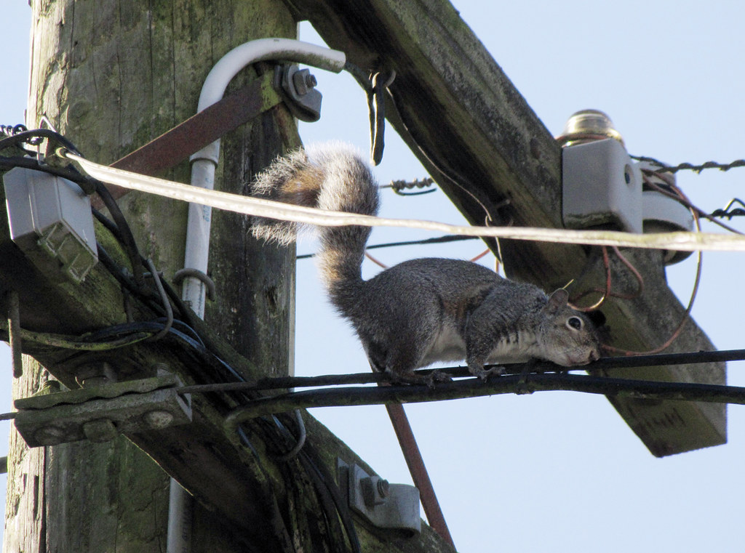
Natural Threats: Wildlife Interactions
Wildlife such as squirrels, birds, snakes, and others can pose a threat to power sector infrastructure.
This may be in the form of interactions with transmission and distribution lines or nesting in substations.
Squirrels have caused hundreds of times the number of power outages as humans.¹
Photo: "Brave Squirrel II" by judy h is licensed under CC BY-NC-SA 2.0
1. https://cybersquirrel1.com/
Notes:
Since 1987, 2492 outages have been recorded as caused by animals. Of those, 1213 were caused by squirrels, 629 by birds, and 116 by snakes. https://cybersquirrel1.com/

Slide 15
Technological Threats

Slide 16
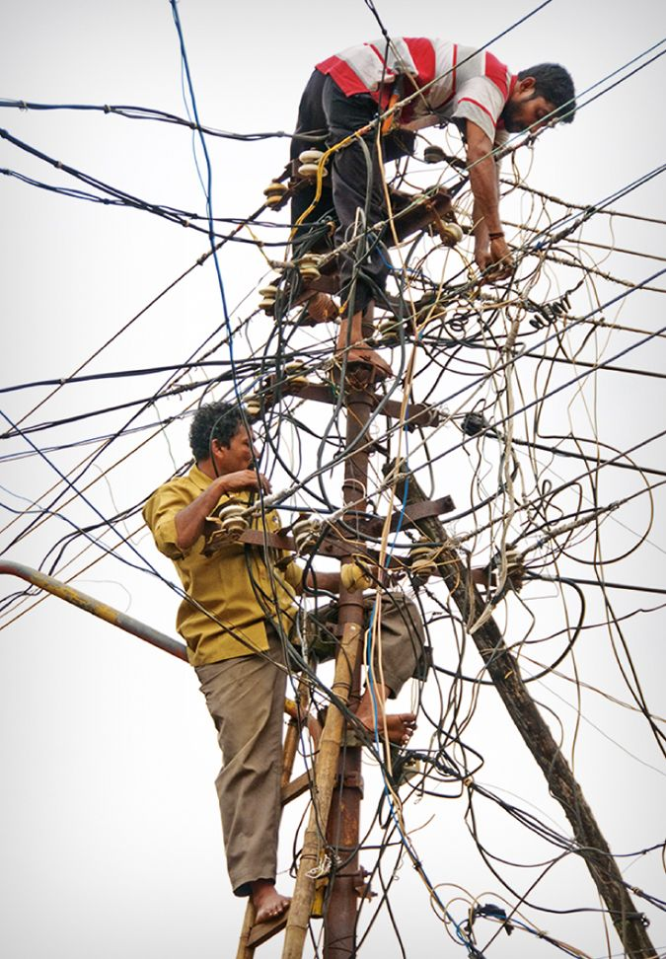
Technological and Human-caused Threats
Technological and human-caused threats involve unknown technological issues and human behavior and are therefore difficult to predict.
Image: Electricity Theft In India
Photo. Braden Gunem, https://www.nature.com/articles/nenergy201644#rightslink

Slide 17
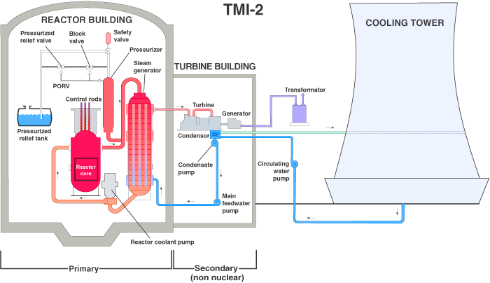
Technological Threats
Technological threats are non-natural threats that directly affect technology and infrastructure.
Examples:
Defects in materials
Poor workmanship or design
Fires from system faults
Technology failures
Unpredictable load shifts
Aging infrastructure
Figure. Three Mile Island Plant. http://www.world-nuclear.org/information-library/safety-and-security/safety-of-plants/three-mile-island-accident.aspx

Slide 18
Human-Caused Threats

Slide 19
Human-Caused Threats: Accidents
There are different types of human threats.
Accidents are unintentional acts that can impact the power system. Common accidents include:
Accidental cutting of power lines
Vehicles hitting power poles and ground based electrical equipment
Electrical workers causing equipment failures
Informal electrical connections
Do accidents occur in your power sector?
We are sure they do!

Slide 20
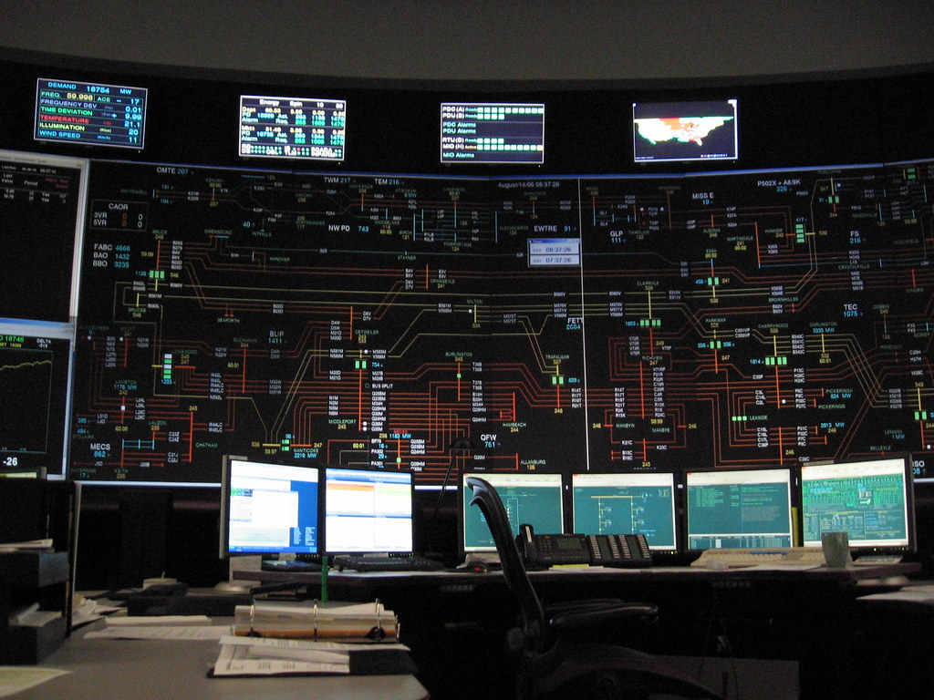
Human-Caused Threats: Incompetence
Due to a number of reasons, a lack of knowledge or experience of those working in the power sector can also be a threat to the system.
Examples:
Lack of adequate worker training
Incompetence in system management
Lack of emergency plans
?
Photo. "Control Room" by ellie vator is licensed under CC BY-NC-ND 2.0

Slide 21
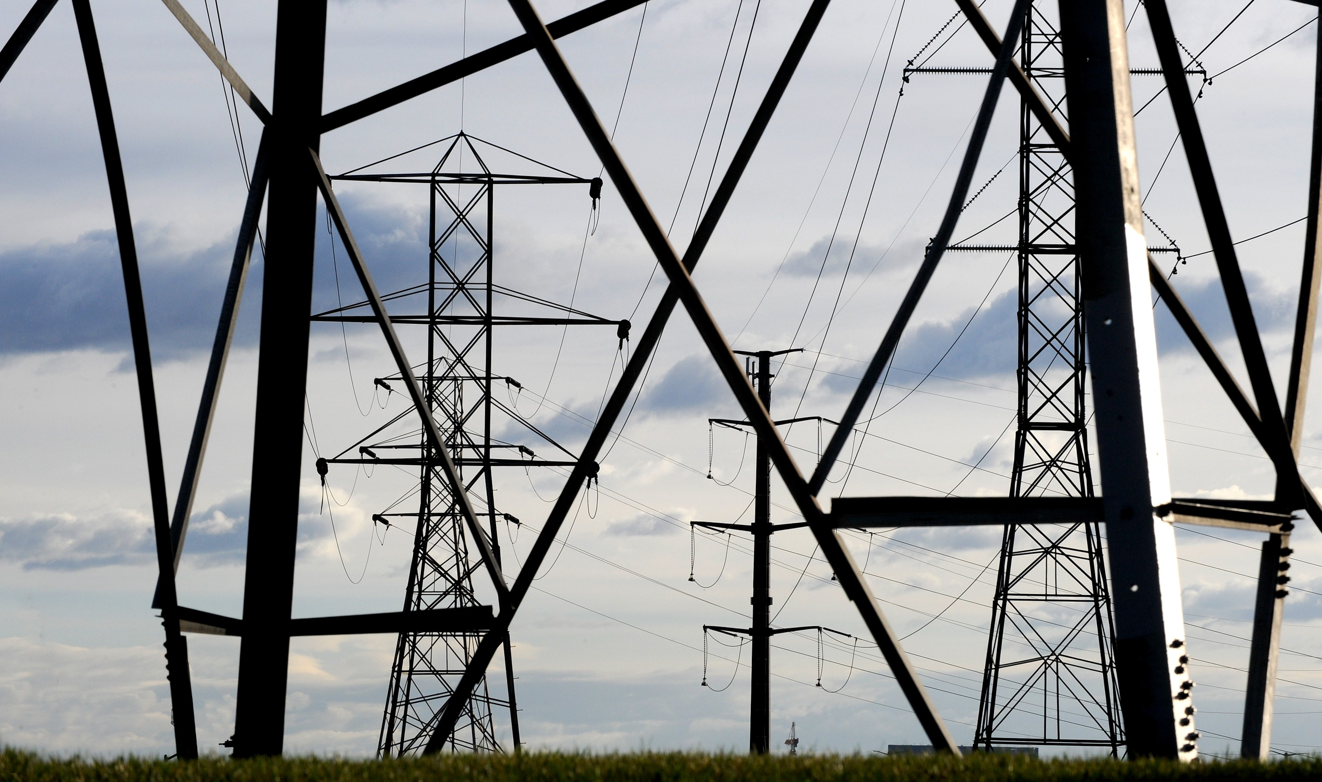
Human-Caused Threats: Bad Actors
Bad actors may arise for any number of reasons:
Some are simply disgruntled power customers that seek to damage power company equipment.
Others may be part of a more organized group seeking political action against the state or individual companies.
Actions may include:
Intentional cutting of lines or destroying of equipment
Arson
Cyber attacks
Acts of terror
Figures from top. D. Schroeder 2017. NREL. Figure # 18981.; https://pixabay.com/en/burglar-thief-criminal-crime-man-308858/

Slide 22
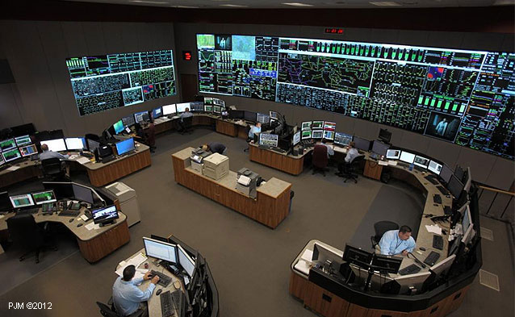
Key Takeaways
Threats are not typically within the control of system planners and operators and can include:
Natural Threats
Cyclones
Extreme precipitation
Extreme heat or cold
Wildlife interactions
Many others
Technological Threats
Defects in materials
Poor workmanship or design
Many others
Human-Caused Threats from:
Accidents
Bad Actors
Figure. Siemens. Siemens platform managing North America’s largest transmission grid (PJM Regional Transmission Organization Control Room). Photo: PJM Interconnection https://w3.siemens.com/smartgrid/global/en/projects/pages/pjm.aspx

